Slide 1
Correlation and Regression

Slide 2
Correlation
Co-relation
The relationship between two variables
Measured with a correlation coefficient
Most popularly seen correlation coefficient: Pearson Product-Moment Correlation

Slide 3
Types of Correlation
Positive correlation
  High values of X tend to be associated with high values of Y.
  As X increases, Y increases
Negative correlation
  High values of X tend to be associated with low values of Y.
  As X increases, Y decreases
No correlation
No consistent tendency for values on Y to increase or decrease as X increases

Slide 4
Pearson's Correlation Coefficient
Measures the strength of the linear relationship between two variables.
A correlation exists between two variables when one of them is related to the other in some way.
Assumes that both variables (often called X and Y) are interval/ratio and approximately normally distributed,

Slide 5
When is it used
Most often in non-experimental situations and field settings
  In these situations it can only tell us about association not causation
  (Scatter plots can be used)

Slide 6
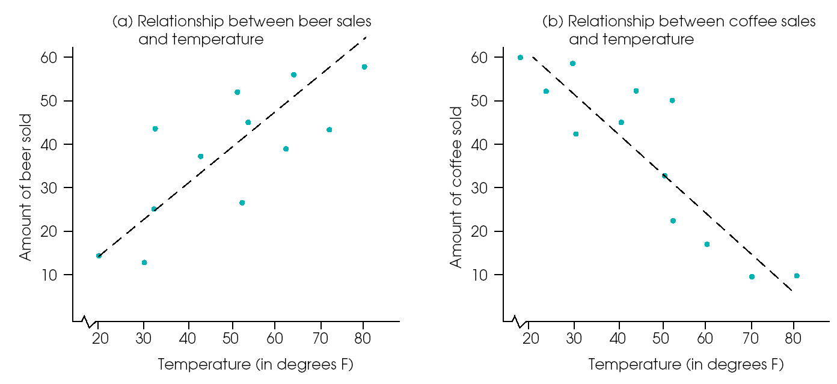
Scatter Plot
Examples of positive and negative relationships. (a) Beer sales are positively related to temperature. (b) Coffee sales are negatively related to temperature.

Slide 7
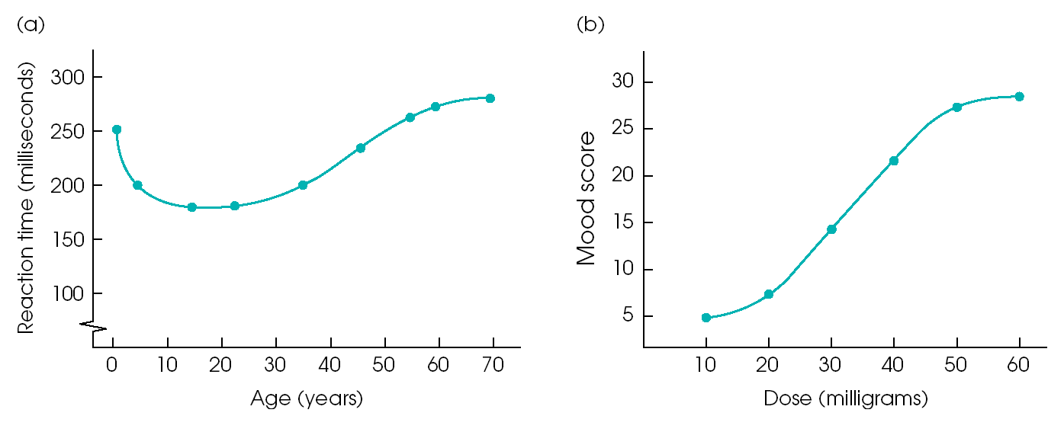
Examples of non-linear relationships
Examples of relationships that are not linear: (a) relationship between reaction time and age; (b) relationship between mood and drug dose.

Slide 8
Types of Correlation
Pearson Product Moment Correlation for continuous data
Spearman’s Rank Correlation
Point-biserial correlation for dichotomous and continuous data
Phi-coefficient
Multiple correlation
Intra-class correlation
Canonical Correlation

Slide 9
Pearson's Correlation Coefficient
Pearson's Correlation Coefficient is usually signified by r (rho), and can take on the values from -1.0 to 1.0.
Where -1.0 is a perfect negative (inverse) correlation, 0.0 is no correlation, and 1.0 is a perfect positive correlation.
R² (called the coefficient of determination or r squared) can be interpreted as the proportion of variance in Y that is contained in X.
The more a set of data co-vary – or appear to be tied then the stronger the relationship

Slide 10
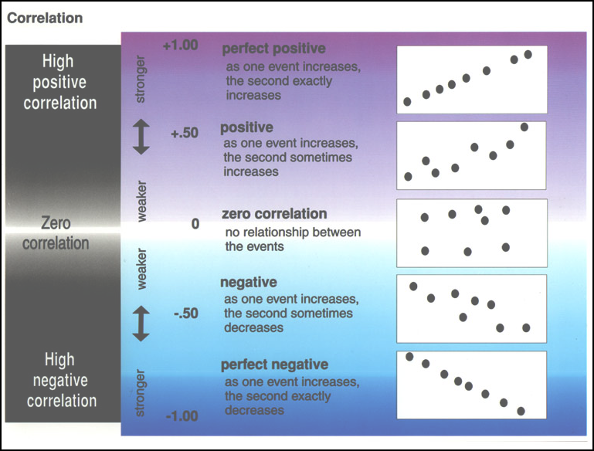

Slide 11
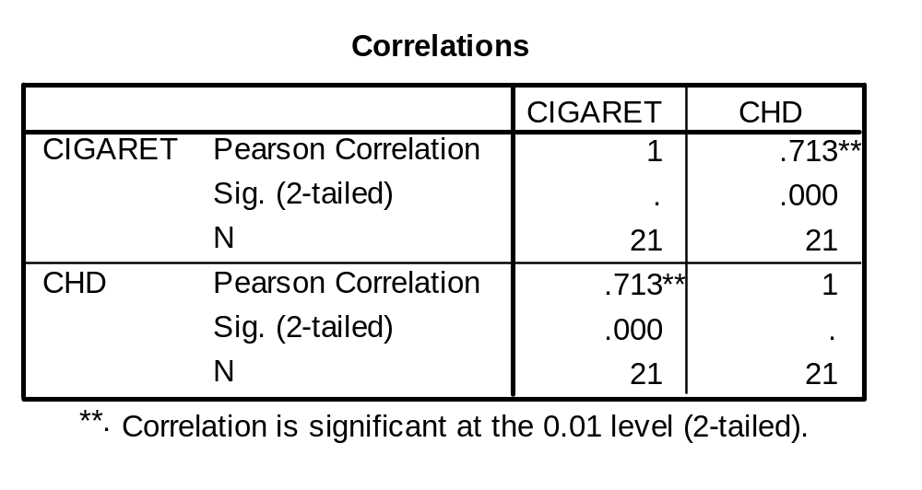
Example: Computer Printout
Printout gives test of significance.

Slide 12
Correlation does not mean Causation

Slide 13
Regression
Predicting one variable from knowledge of another e.g.,
    Personality and job performance (Organisational Psychology)
    Attitude and subsequent behaviour (Consumer Psychology)
    Clinician behaviour and therapeutic success (Clinical Psychology)

Slide 14
Linear Regression
To find the relationship between two variables
The regression equation y = b0 +b1x algebraically describes the relationship between the two variables.
One variable, usually called x, is the independent
Variable
The other variable, usually called y, is the dependent
Variable
The two constants b0 and b1 are called the
regression coefficients

Slide 15
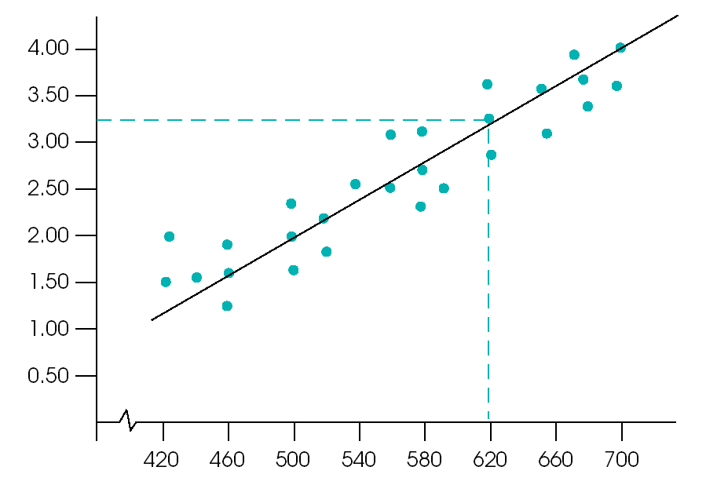
Simple Linear Regression
Y=bX + a
The regression line is the best fit through the data. Best fit is defined as the average line – the one that minimises the distance between the data points and the line. It is the best description of the data

Slide 16
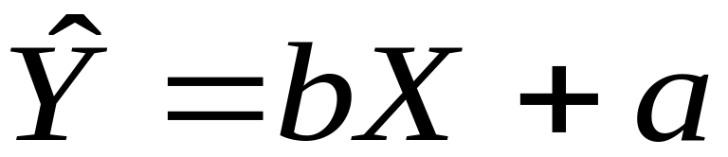

Regression Line
Formula
  = the predicted value of Y
  X = the predictor variable

Slide 17

Regression Coefficients
“Coefficients” are a and b
b = slope
  Change in predicted Y for one unit change in X
a = intercept
  value of when X = 0

Slide 18
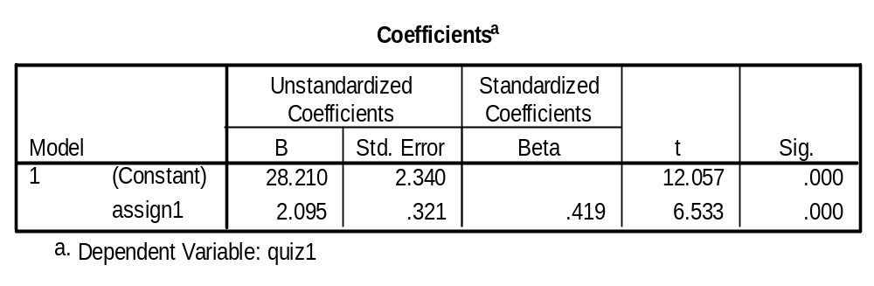
Standardised regresssion coefficient. A one std deviation change in x will produce a 0.419 std deviation change in Y
Value of Y when X=0 known as the intercept or constant (a)
Value of a
Value of b: a one unit change in x produces a 2.095 unit change in Y
Name of predictor variable(s)

Slide 19
R-squared value
R²-value measures the percentage of variation in the values of the dependent variable that can be explained by the variation in the independent variable.
R²-value varies from 0 to 1.
A value of 0.7654 means that 76.54% of the variance in y can be explained by the changes in X. The remaining 23.46% of the variation in y is presumed to be due to random variability.

Slide 20
An Example
Cigarettes and CHD (Congenital Diaphragmatic hernia) Mortality rate.
We want to predict level of CHD mortality in a country averaging 10 cigarettes per day.
Notes:
Landwehr, J.M. & Watkins, A.E. (1987) Exploring Data: Teacher’s Edition. Palo Alto, CA: Dale Seymour Publications.

Slide 21
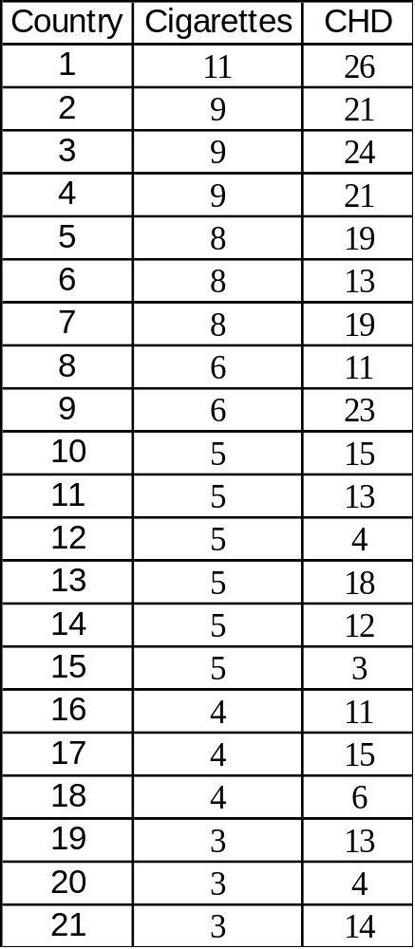
The Data
Based on the data we have what would we predict the rate of CHD be in a country that smoked 10 cigarettes on average?
First, we need to establish a prediction of CHD from smoking…

Slide 22
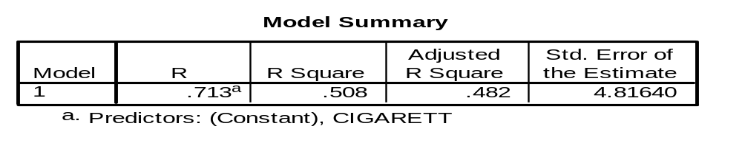
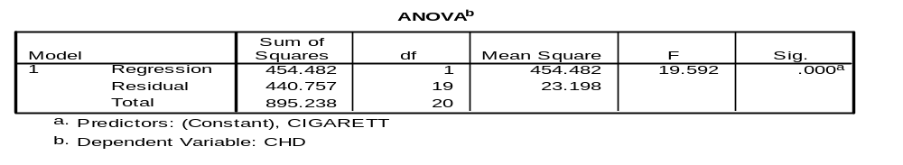
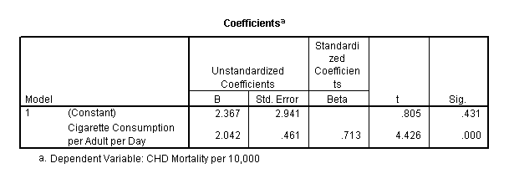
SPSS Printout

Slide 23
Note:
The values we obtained are shown on SPSS printout.
The intercept is the value in the B column labeled “constant”
The slope is the value in the B column labeled by name of predictor variable.

Slide 24
Regression Line
Formula
  = the predicted value of Y (e.g. CHD mortality)
  X = the predictor variable (e.g. average cig./adult/country)

Slide 25
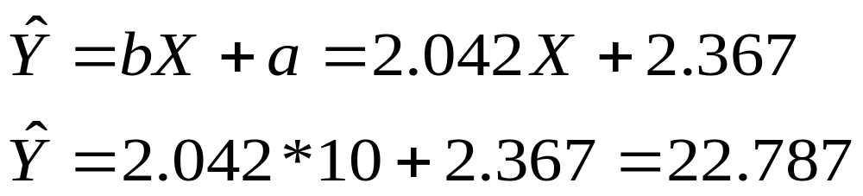
Making a Prediction
Based on the values from SPSS printout, once we know the relationship we can predict
We predict 22.79 people/10,000 in a country with an average of 10 C/A/D will die of CHD

Slide 26
Exercise: SPSS tutorial (YouTube)
Pearson Correlation – SPSS
https://www.youtube.com/watch?v=VOI5IlHfZVE
https://www.youtube.com/watch?v=xac5d0W82pI
Correlation and Regression Analysis in SPSS
https://www.youtube.com/watch?v=Il2NAm287LM
The End

